Slide 1
Healthcare Safety Analysis: Insights from MetroHealth83 Dataset
A Data-Driven Approach to Improve Public Health
Presented by Swapnil Nicolson Dadel
Date: July 22, 2025
https://github.com/swapitsneil/healthcareanalysis
Notes:
Welcome everyone! Today, we’ll explore how Power BI transformed raw data into actionable insights for healthcare safety. Let’s dive in!

Slide 2
Project Overview
Analyzed MetroHealth83 dataset (77 cities, 17 columns).
Focused on RateMDs, RateBeds, PctChangeMedicare, and new features (newHAI, newPDI, newMedicareDependencyRatio).
Goal: Address healthcare disparities and safety risks.
Notes:
This project uses Power BI to turn healthcare metrics into a roadmap for improvement, setting the stage for our findings.

Slide 3
Phase 1 - Data Acquisition and Preparation
Task 1: Loaded MetroHealth83.csv (83 rows, 16 columns).
Task 2: Confirmed high quality, no missing data, relevant metrics.
Task 3: Removed 6 duplicates, capped RateMDs at 510, RateBeds at 550, estimated Population.
Notes:
We started with a solid foundation by cleaning and preparing the data, ensuring accuracy for analysis.

Slide 4
Phase 2 - Data Exploration and Visualization
Task 4: Histogram showed RateMDs peak at 150–300.
Task 5: Bar chart highlighted low RateMDs (<150), scatter plot linked RateMDs and RateBeds.
Task 6: Scatter plot identified RateBeds outliers (>585), capped at 585.
Notes:
Exploration revealed key patterns, like low physician rates posing safety risks across cities.

Slide 5
Phase 3 - Data Analysis and Feature Engineering
Task 7: Univariate (histogram, card) and bivariate (scatter, matrix) analyses linked RateMDs with safety risks.
Task 8: Created newHAI, newPDI, newMedicareDependencyRatio via DAX.
Task 9: Capped outliers (newHAI >400, newPDI >1000, newMedicareDependencyRatio >15).
Notes:
New features enhanced our ability to predict and manage safety incidents effectively.

Slide 6
Phase 4 - Reporting and Documentation
Task 13: Summarized low RateMDs and high newPDI as safety threats.
Task 14: Enhanced visuals (histogram, combo chart, scatter, matrix) for impact.
Task 15: Documented analysis, DAX-based feature engineering, and recommendations.
Notes:
Reporting turned insights into a clear, actionable narrative for stakeholders.

Slide 7
Phase 5 - Real-World Applications
Task 16: Applied visuals to target Hanford-Corcoran (low RateMDs) and Scranton (negative PctChangeMedicare).
Task 17: Recommendations improved resource allocation and emergency response.
Notes:
These insights address real healthcare challenges, enhancing safety operations practically.

Slide 8
Project Conclusion
Task 18: Key findings: Low newHAI and high newPDI indicate risks; high newMedicareDependencyRatio signals vulnerability.
Significance: Offers a scalable model for public health planning.
Notes:
Our work provides a foundation for safer, data-driven healthcare systems with broad impact.

Slide 9
Future Steps
Task 19: Future extensions include real-time data, patient outcomes, and machine learning.
Refinements: Adjust outlier thresholds, validate Population estimates.
Notes:
This project opens doors for deeper analysis and broader healthcare improvements.

Slide 10
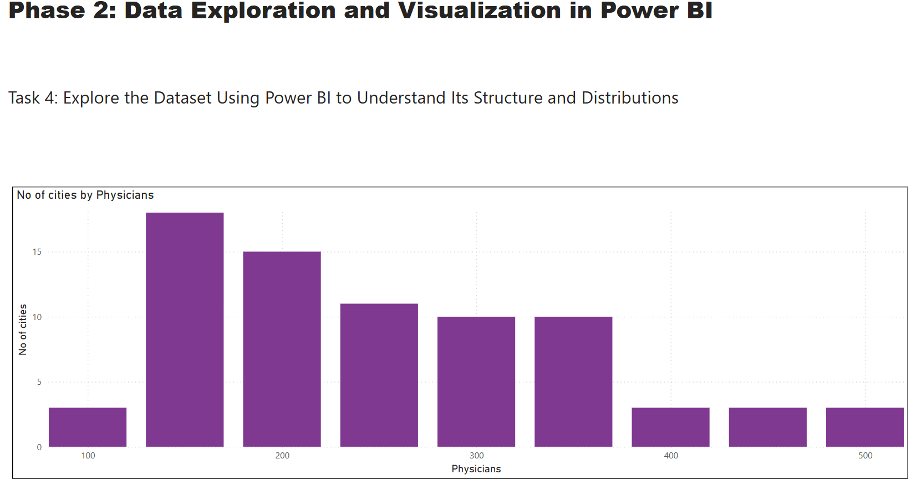
POWERBI

Slide 11
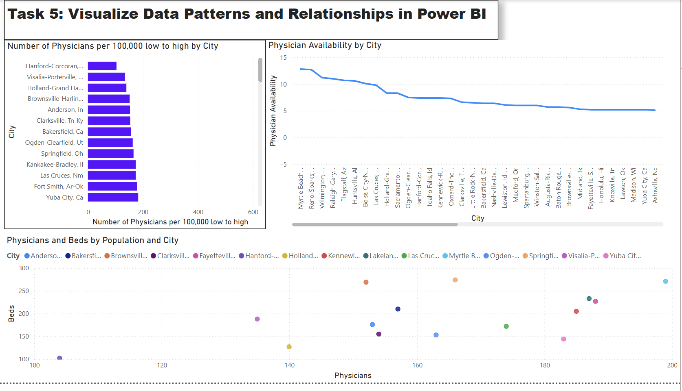

Slide 12
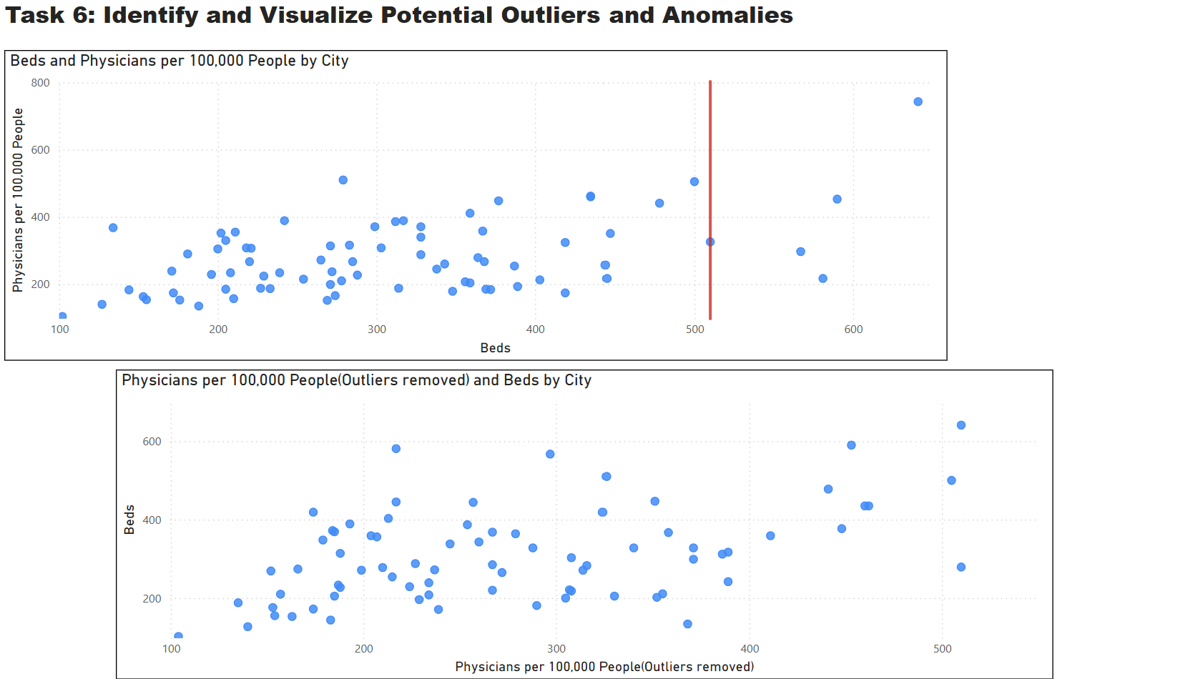

Slide 13
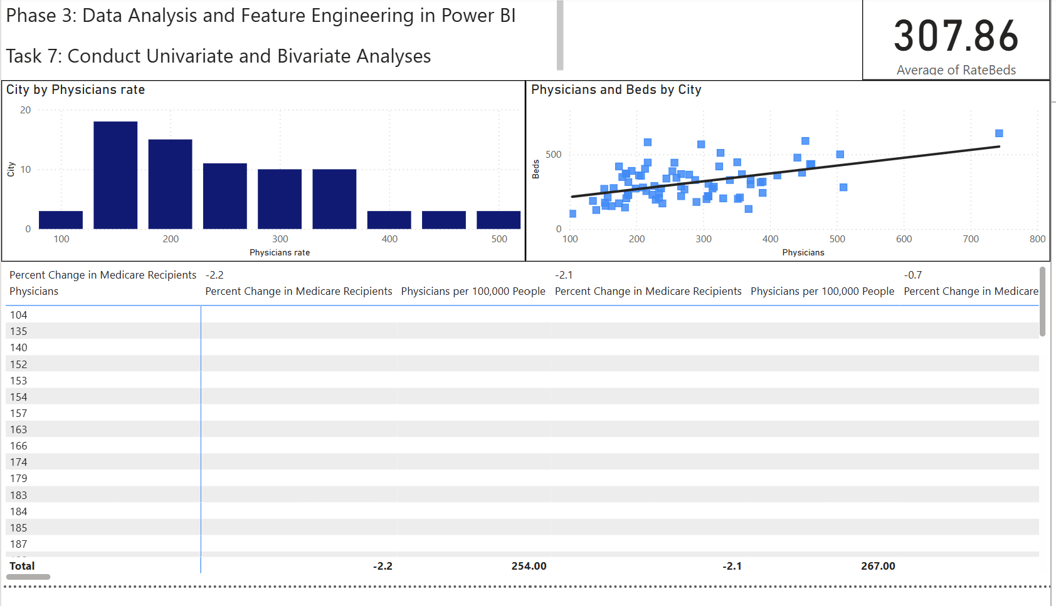

Slide 14
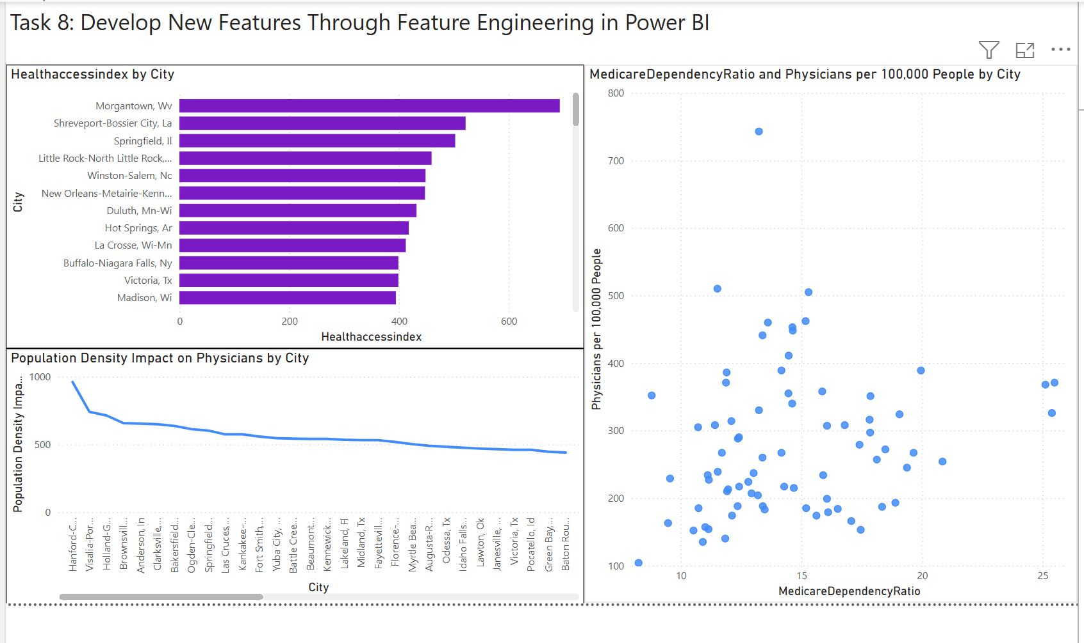

Slide 15
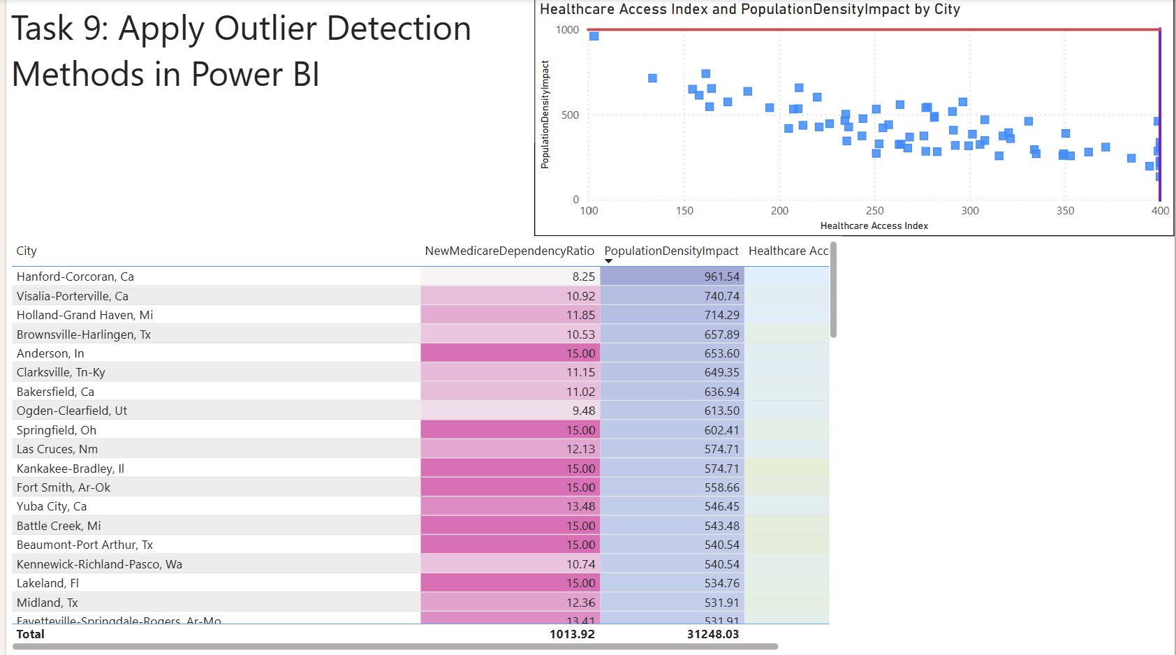

Slide 16
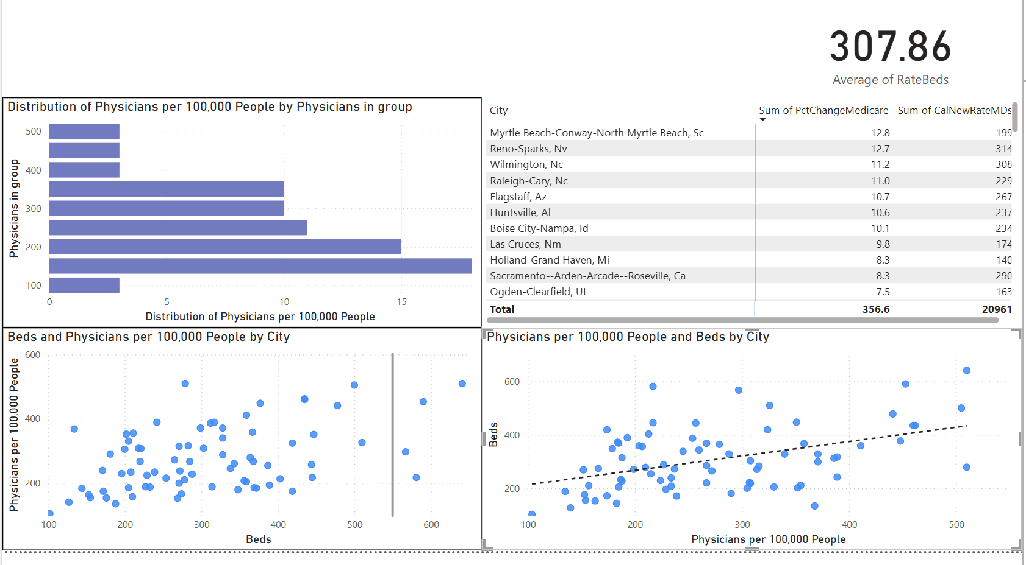

Slide 17
THANK YOU

